Slide 1


Slide 2
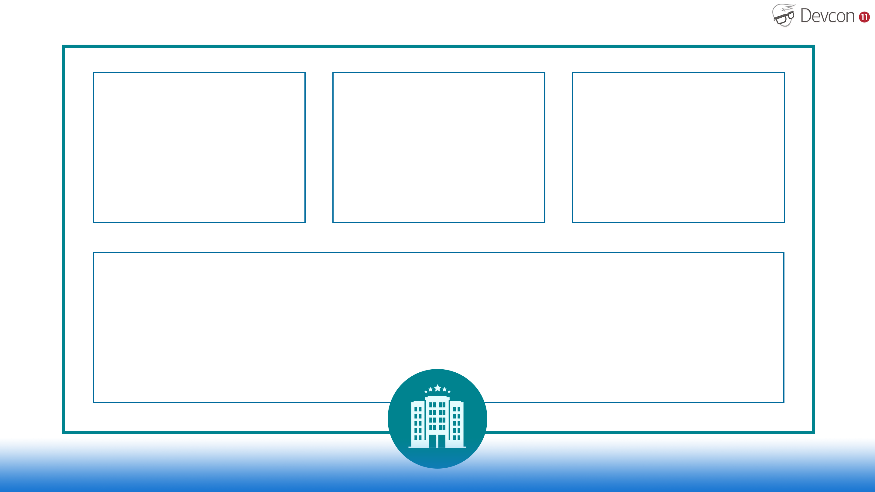
Bedroom
Bedroom
Bedroom
Kitchen and Bathroom

Slide 3

Bedroom
Bedroom
Bedroom
Kitchen and Bathroom

Slide 4
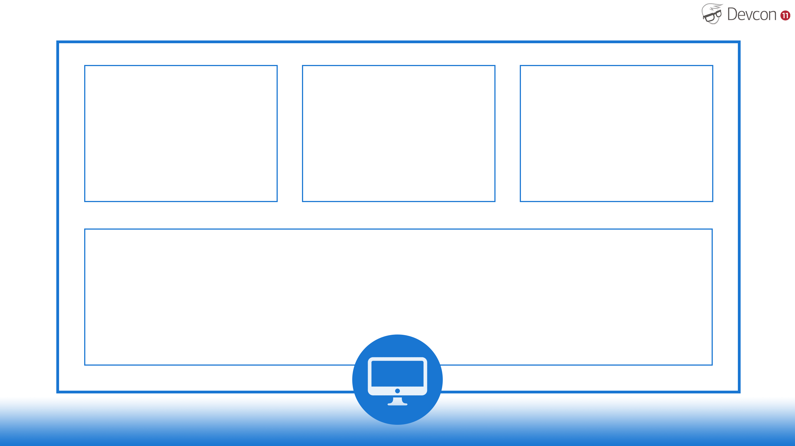

App 1
App 2
App 3
Needs
Version 1
Needs
Version 2
Needs
Version 3
Libraries and Frameworks
Kitchen and Bathroom
Python
Python (Version 3)

Slide 5
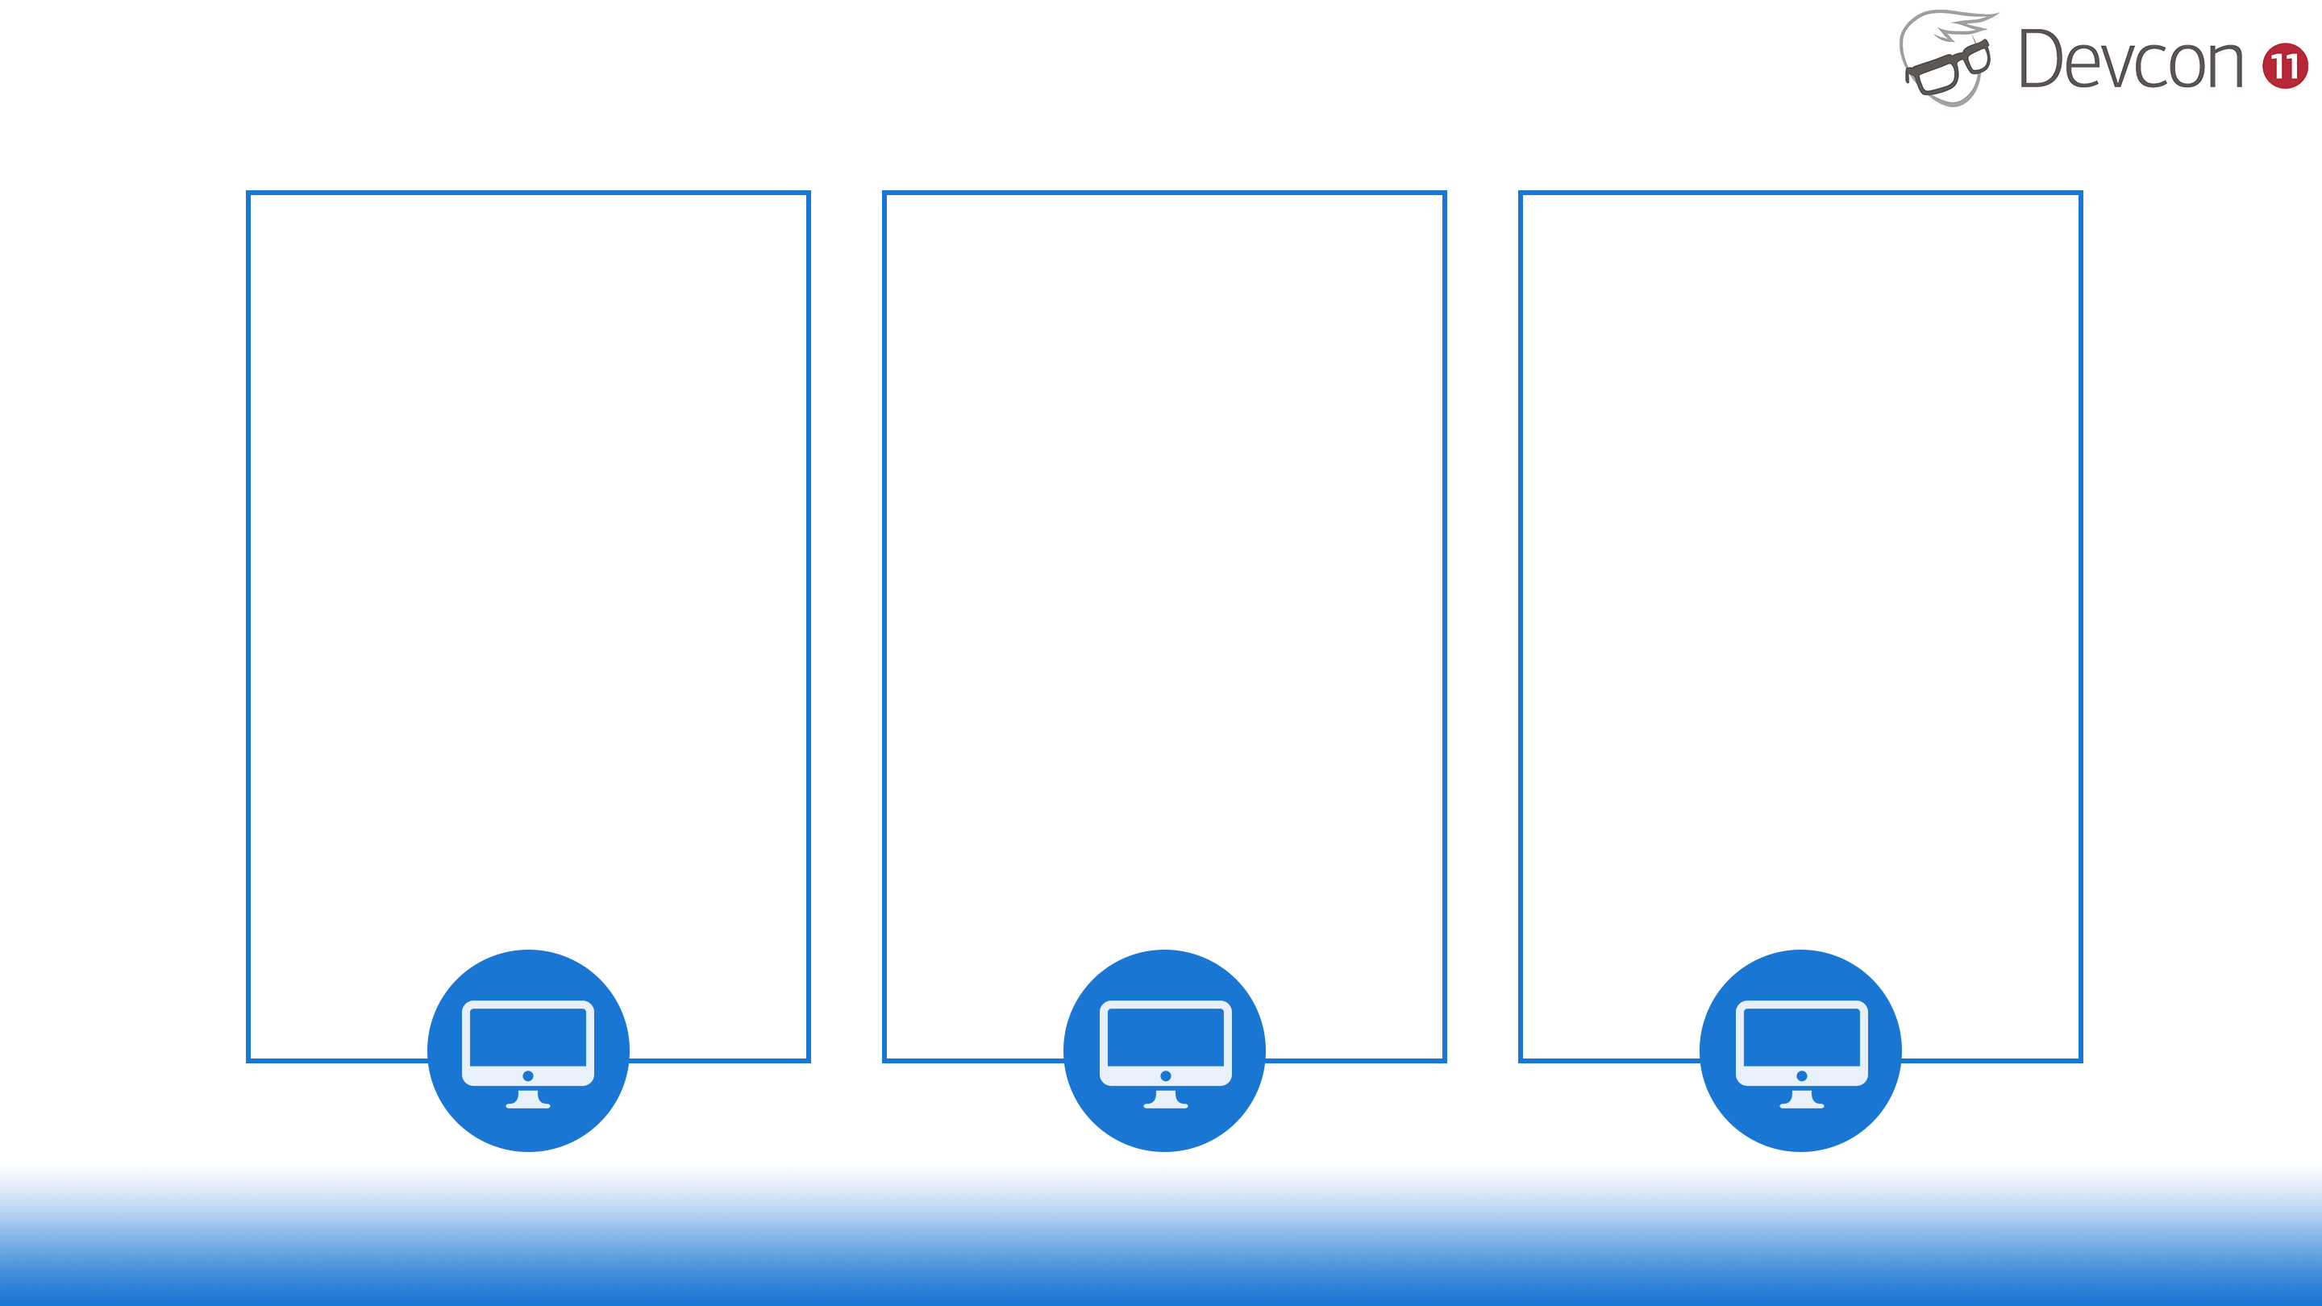
Solution 1
App 1
App 2
App 3
Needs
Version 1
Needs
Version 2
Needs
Version 3
Python
Python
Python
Version 1
Version 2
Version 3

Slide 6
Bedroom,
Kitchen
And
Bathroom
Bedroom,
Kitchen
And
Bathroom
Bedroom,
Kitchen
And
Bathroom
Bedroom
Bedroom
Bedroom
Kitchen and Bathroom

Slide 7
App 1
Needs
Version 1
App 2
Needs
Version 2
App 3
Needs
Version 3
Python
Version 1
Python
Version 2
Python
Version 3

Slide 8
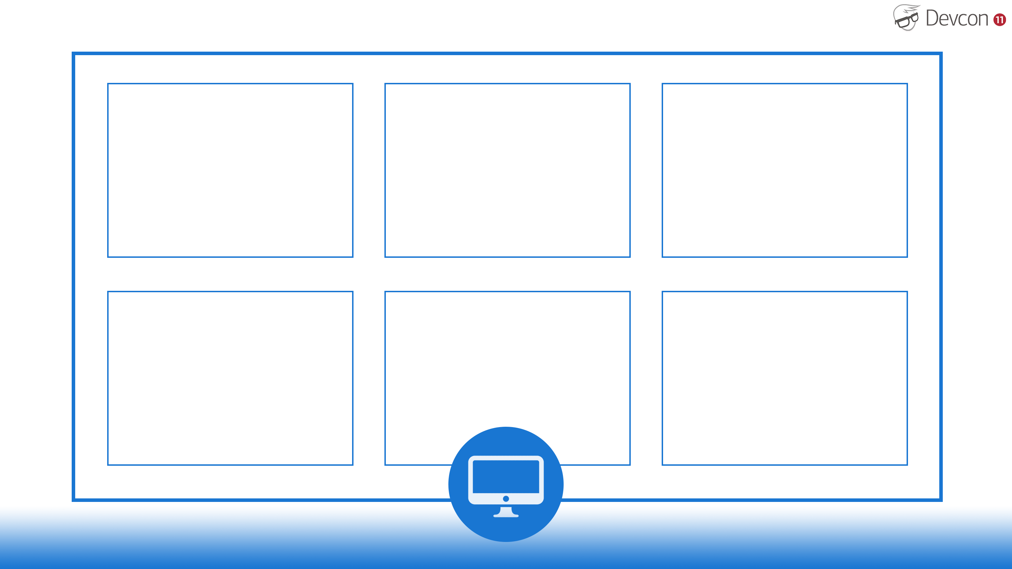
App 1
Needs
Version 1
App 2
Needs
Version 2
App 3
Needs
Version 3
Python
Version 1
Python
Version 2
Python
Version 3
App 4
Needs
Version 4
App 5
Needs
Version 5
App 6
Needs
Version 6
Python
Version 4
Python
Version 5
Python
Version 6

Slide 9
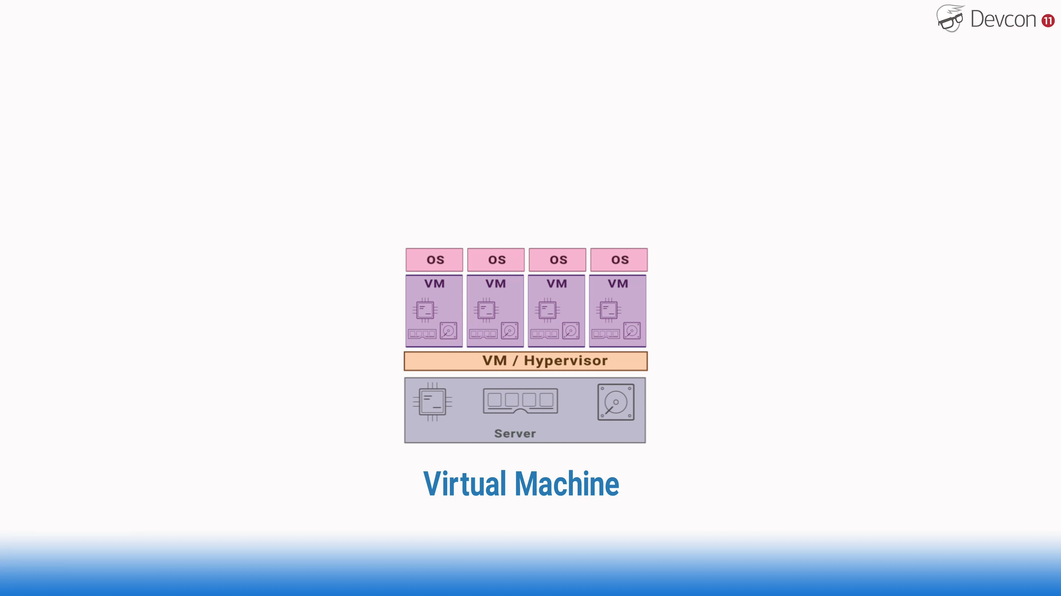

Slide 10
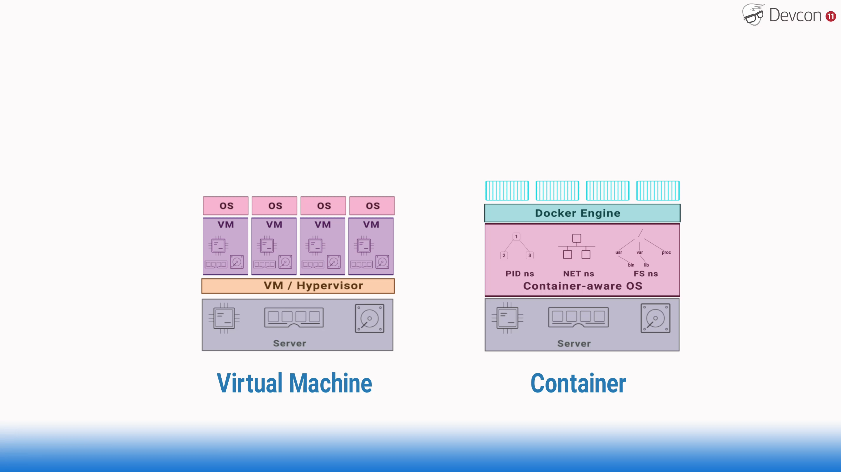

Slide 11
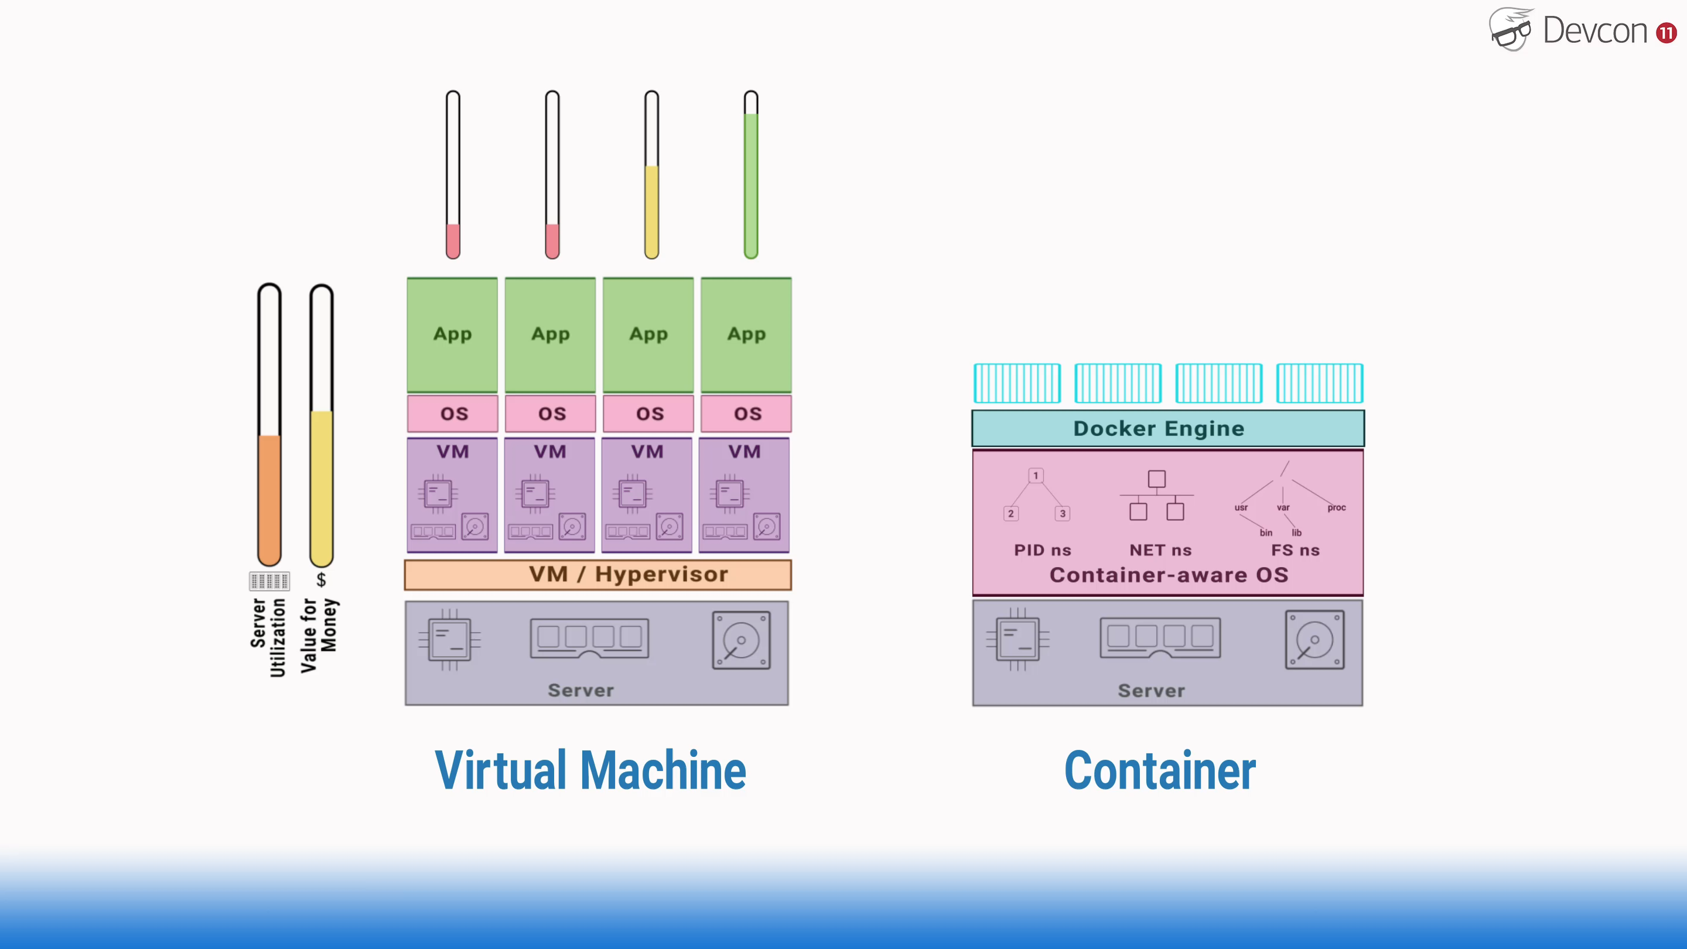

Slide 12
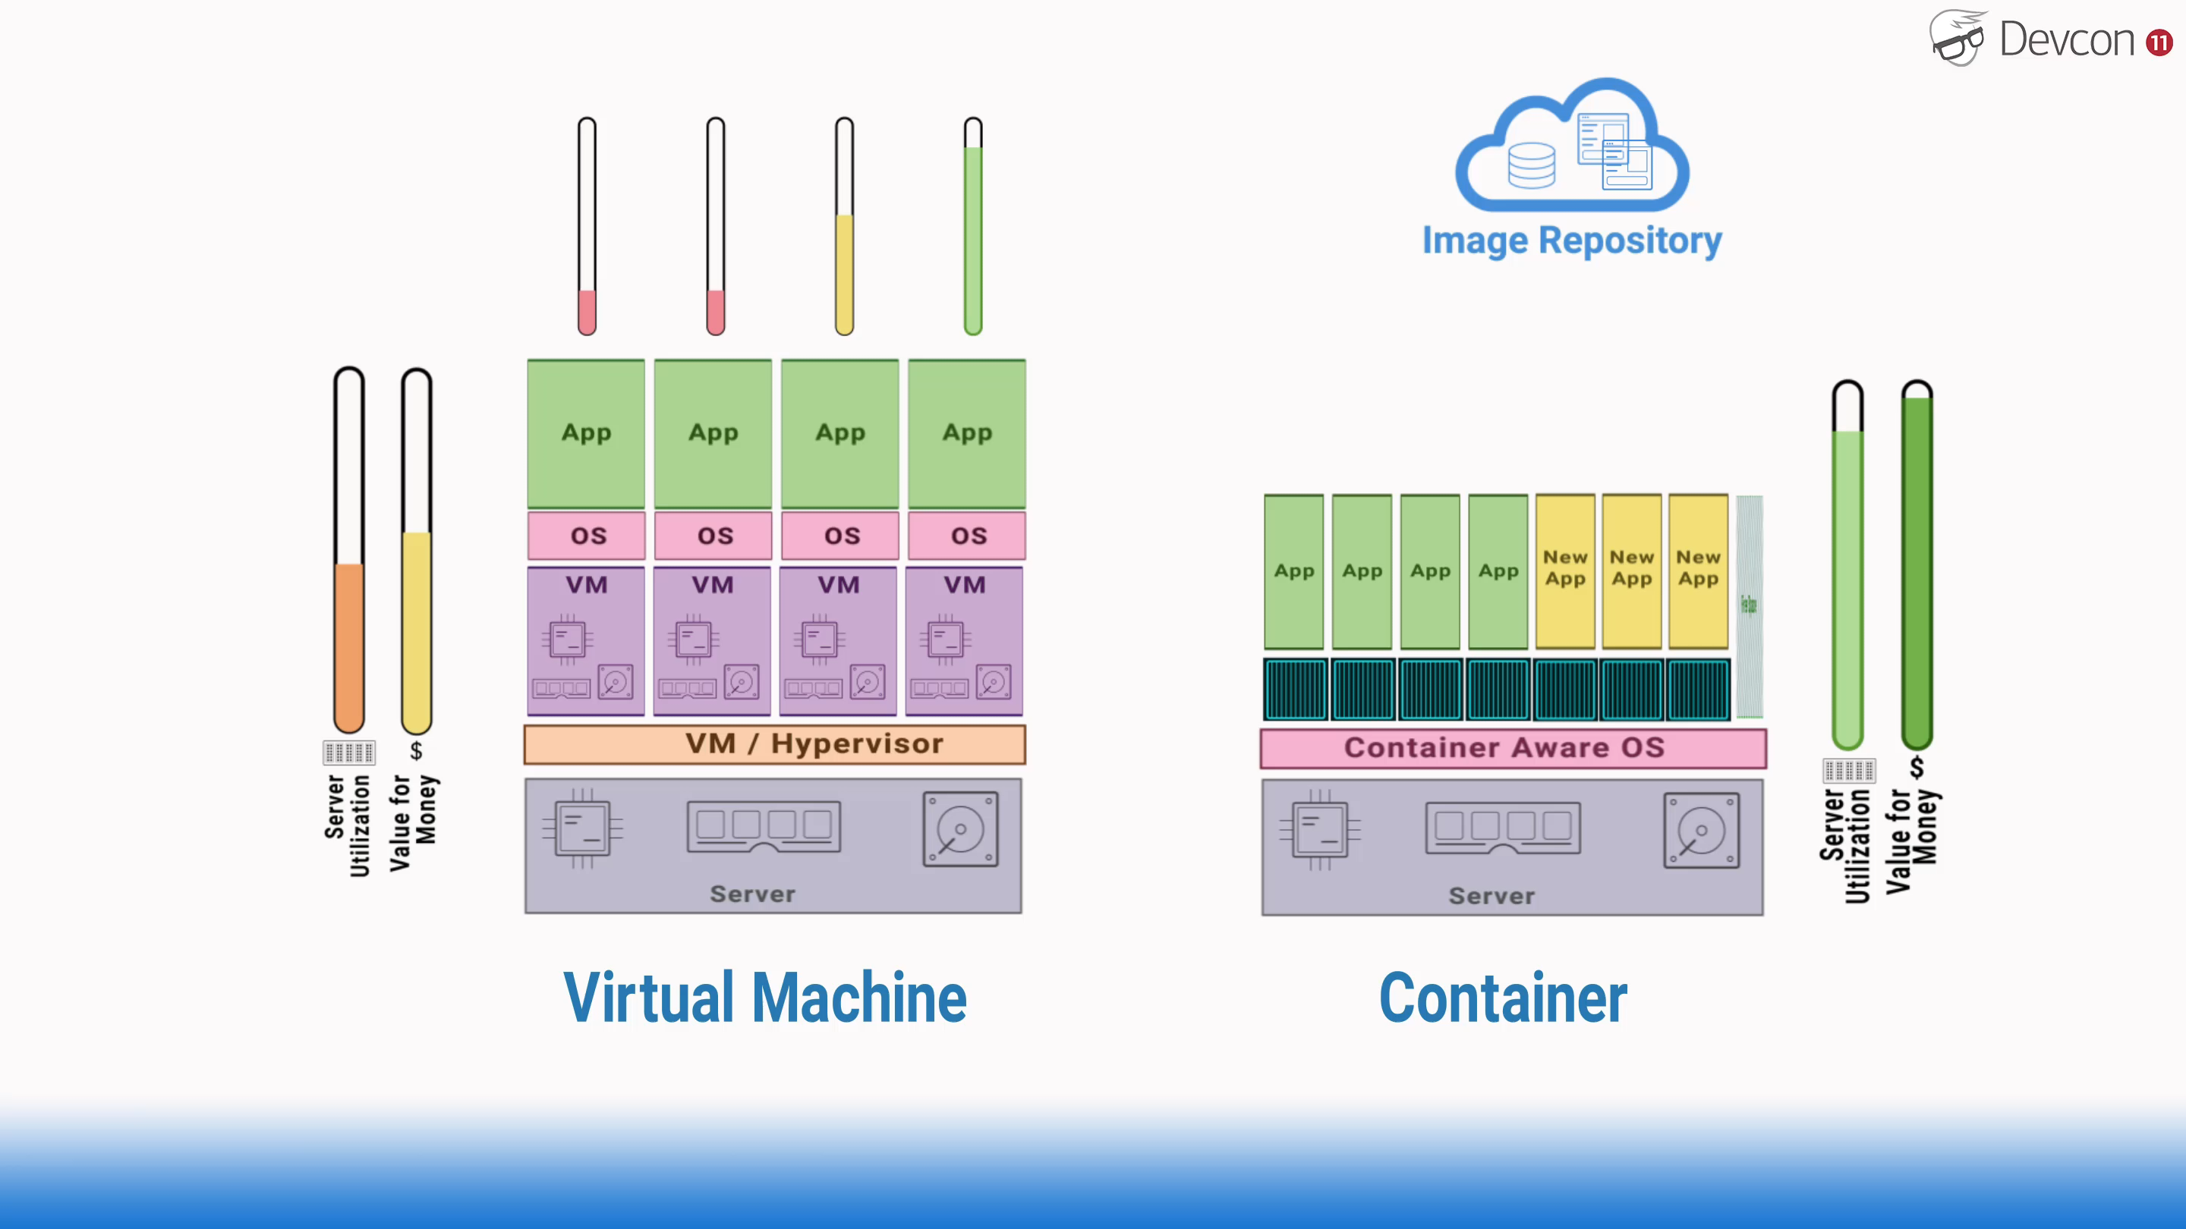

Slide 13
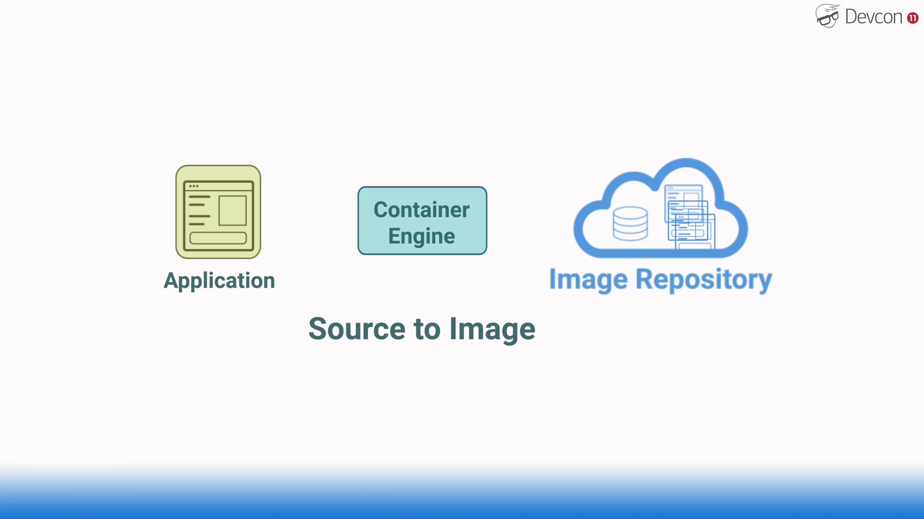

Slide 14
